Slide 1
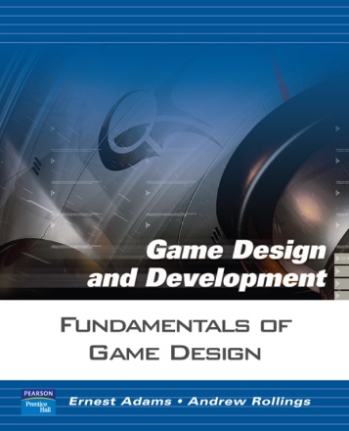
Game Balancing Fundamentals of Game Design
by Ernest Adams and Andrew Rollings adapted by Jarek Francik for Game Design course at Kingston University
Chapter 11: Game Balancing

Slide 2
Objectives
How to design a fair game
How to avoid dominant strategies
How to use chance
How to design games that are fair
How to manage difficulty
How to control positive feedback
How to design games that are easy to tune

Slide 3
What Is a Balanced Game?
A balanced game
Is fair to the player(s)
Is neither too easy nor too hard
Makes the skill of the player the most important factor in determining his success
Concept of balance differs between PvP and PvE games
PvP = Player v. Player
PvE = Player vs Environment

Slide 4
What Is a Balanced Game? (Cont.)
A well-balanced PvP or PvE game has the following characteristics:
It provides meaningful choices
It avoids dominant strategies
Each strategy must have a reasonable chance of producing victory
Player’s skill must affect success
Role of chance should not be so great that player skill becomes irrelevant

Slide 5
What Is a Balanced Game? (Cont.)
Additional balance requirements for PvP
Players perceive the game to be fair
A player who falls behind should have opportunities to catch up
Game rarely ends in a stalemate
Additional balance requirements for PvE
The player perceives the game to be fair
Definition of fairness is different—discussed later
Level of difficulty must be consistent

Slide 6
Avoiding Dominant Strategies
Dominant strategy is a strategy that reliably produces the best outcome a player may achieve, no matter what his opponent does
Dominant strategies are undesirable because a player has no reason to use any other strategy once she has discovered the dominant strategy
Command & Conquer: Red Alert Tank Rush Strategy
Playing as a Soviet side produce a large force of tanks in the early stage, then use them to attack.
Two Common Strategies in RTS games:
Turtling build up defences and production capacity while holding off enemy attacks
Rushing attack early to overwhelm the opposition before they have a chance to. high risk / high reward strategy

Slide 7
Avoiding Dominant Strategies (Cont.)
Rock
Scissors
Paper
Dominant strategies in video games
Transitive relationships among three or more entities
If A > B and B > C, then A > C
Never any reason to choose B or C if A is best
To correct the imbalance, assign costs to each choice
To create a more interesting choice, impose shadow costs for choices
Transitive relationships often used to create upgrades for a player’s abilities—start with C and earn B, then A

Slide 8
Avoiding Dominant Strategies (Cont.)
Dominant strategies in video games (cont.)
Intransitive relationships (rock-paper-scissors)
If A beats B and B beats C, you can’t assume A beats C
Rather, A beats B, B beats C, and C beats A
RPS model is simple but can be adjusted by modifying core mechanics
Orthogonal unit differentiation—each kind of unit should be unlike the others in a different dimension
Guarantees each kind of unit has a unique function

Slide 9
Avoiding Dominant Strategies (Cont.)
Dominant strategies in PvE games
Implementing fewer actions in a game risks creating exploits—actions that can beat any challenge
Test thoroughly to eliminate exploits
Unintended Dominant Strategy: One old game allowed the player to win by upgrading a weapon and then just running as low on the screen as possible, keeping finger on the fire button all time.
Another game made normally impossible jumps to be achieved by using a rocket in unintended way

Slide 10
The Role of Chance
If chance plays a role, how to ensure the more skillful player wins?
Use chance sparingly
Use chance in frequent challenges with small risks and rewards (poker)
Allow player to choose actions
Allow player to choose how much to risk

Slide 11
Making PvP Games Fair
To balance symmetric games, treat every player the same
Same rules, resources, victory conditions
Asymmetric games are harder to balance
Give players identical quantities of materials or points when they start
Players spend points to build units as they wish
Unit attributes should differ among players

Slide 12
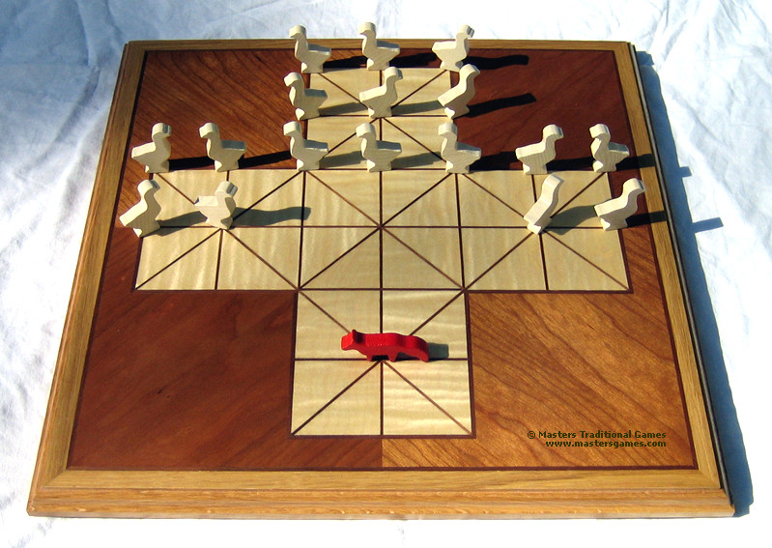
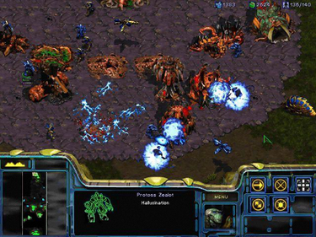
Making PvP Games Fair
StarCraft
Terrans: construction units can repair other units
Damaged Zerg units heal themselves but at fixed rate
Protoss units possess both health and shields, but usually cost twice as much.
To balance symmetric games, treat every player the same
Same rules, resources, victory conditions
Asymmetric games are harder to balance
Give players identical quantities of materials or points when they start
Players spend points to build units as they wish
Unit attributes should differ among players

Slide 13
Making PvP Games Fair (Cont.)
Balance issues for persistent worlds
Persistent worlds are never symmetric and always intrinsically unbalanced
New players need protection
Can be rebalanced on the fly by patching

Slide 14
Making PvE Games Fair
A fair PvE game should
Offer challenges at a consistent level of difficulty
Avoid learn-by-dying designs
Avoid stalemates and deadlocks
Provide information for critical decisions
Avoid requiring extrinsic information
Include challenges appropriate for the genre

Slide 15
Csikszentmihalyi’s Flow
a
Anxiety
FLOW
Difficulty
Boredom
Player Ability

Slide 16
Managing Difficulty
Balancing a game includes managing the difficulty of its challenges to keep players within a flow state
Factors outside the designer’s control
Previous experience facing challenges similar to those in your game
Native talent such as hand-eye coordination and reasoning skills
Notes:
Flow occurs when the player’s abilities balance the challenge.

Slide 17
Managing Difficulty (Cont.)
Types of difficulty
Absolute difficulty—compare amounts of skill required and stress to that of a similar trivial challenge
Relative difficulty – difficulty relative to player’s power provided by the game
Power provided measures player’s strength by means appropriate to situation (e.g., weapon strength in shooters)
Perceived difficulty = absolute difficulty − (power provided + in-game experience)
Notes:
Reminder from Chapter 9: Intrinsic skill needed to overcome challenge + stress = absolute difficulty.

Slide 18
Managing Difficulty (Cont.)
Power provided to meet challenges
Absolute
Difficulty
Difficulty
In-game experience the player has had
Relative
Difficulty
Perceived
Difficulty
Time

Slide 19
Managing Difficulty (Cont.)
Absolute
Difficulty
Power provided to meet challenges
Difficulty
Relative
Difficulty
In-game experience the player has had
Perceived
Difficulty
Time

Slide 20
Managing Difficulty (Cont.)
Creating a difficulty progression
Perceived difficulty of challenges should stay the same or rise
In games for casual players and young children, it should remain almost flat
Relative difficulty must increase over time to counteract the player’s growing in-game experience

Slide 21
Managing Difficulty (Cont.)
Establishing difficulty modes
In single-player games, allow player to choose a difficulty mode
When a difficulty mode is selected, challenges must stay within that range
If you can’t adjust the difficulty of a challenge, provide a way around it for the easy mode and block the go-around route for the hard mode

Slide 22
Difficulty Chainsaw Model
Perceived Difficulty
level 1
level 2
level 3
level 4
level 5
Time

Slide 23
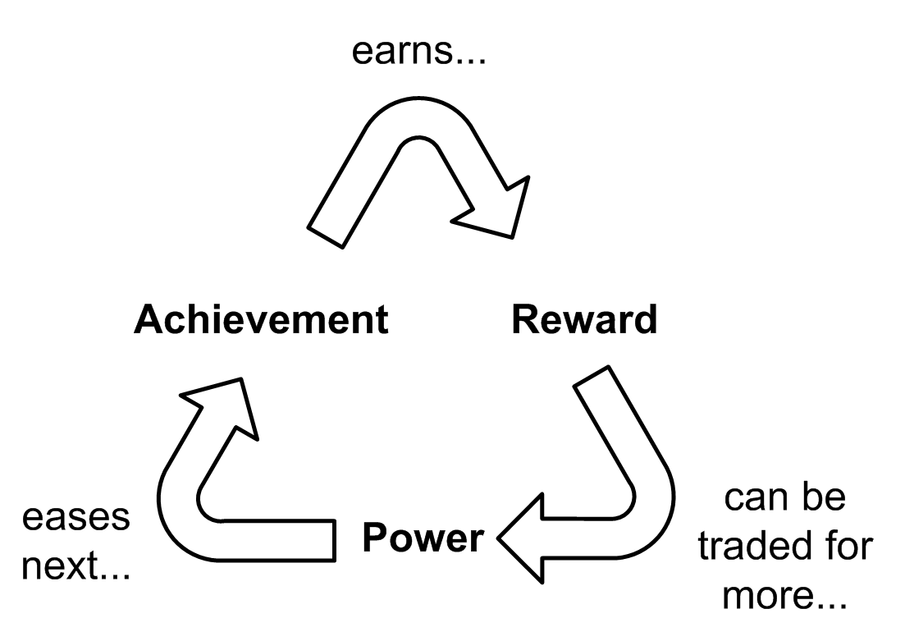
Understanding Positive Feedback
Positive feedback occurs when a player’s achievement changes the game state, making future achievements easier
Benefits of positive feedback
Discourages a stalemate
Rewards success

Slide 24
Understanding Positive Feedback (Cont.)
Controlling positive feedback
Don’t give too much power as a reward
Introduce negative feedback
Raise the absolute difficulty level of challenges as the player proceeds
Use chance to reduce the size of the rewards
Notes:
Review the graphs in Figure 11.8.

Slide 25
Other Balance Considerations
Avoid stagnation
Stagnation occurs when the player does not know what to do next
Hide clues in plain sight about how to proceed
Have the game detect when the player is wandering aimlessly and provide nudges in the right direction
Avoid trivialities
Let the computer handle uninteresting details of game

Slide 26
Design to Make Tuning Easy
Generalize mechanics when possible
Try to avoid creating special cases
Separate code and data
Suggestions for efficient fine-tuning:
Modify only one parameter at a time
When modifying parameters, make big adjustments—the consequences are easier to see
Keep records
Use pseudo-random numbers

Slide 27
Summary
You should now understand
How to design a fair game
How to avoid dominant strategies
How to use chance
How to manage difficulty
How to control positive feedback

